Slide 1
Module 4: Optical Detectors Basics of photodetectors
EXTC – BE – Optical Communication (ECC703)
Prof. Shyamala Mathi
Assistant Professor
Dept. of Electronics and Telecommunication,
SIES Graduate School of Technology

Slide 2
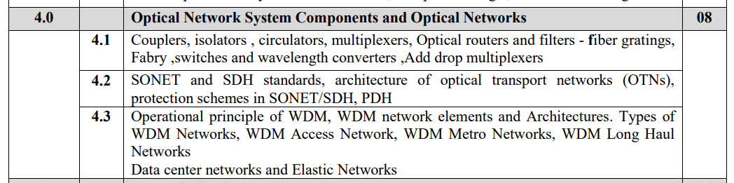

Slide 3
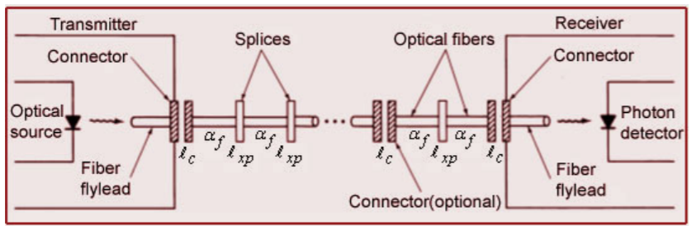
Link Power Budget

Slide 4
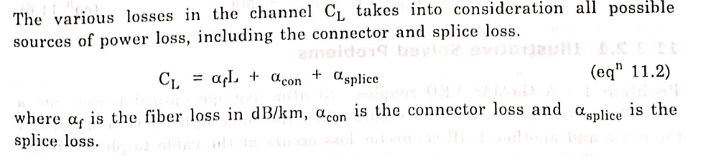

Slide 6
Length of fiber = 86 km.
Splices are used after every kilometer.
Find the safety Margin.

Slide 12
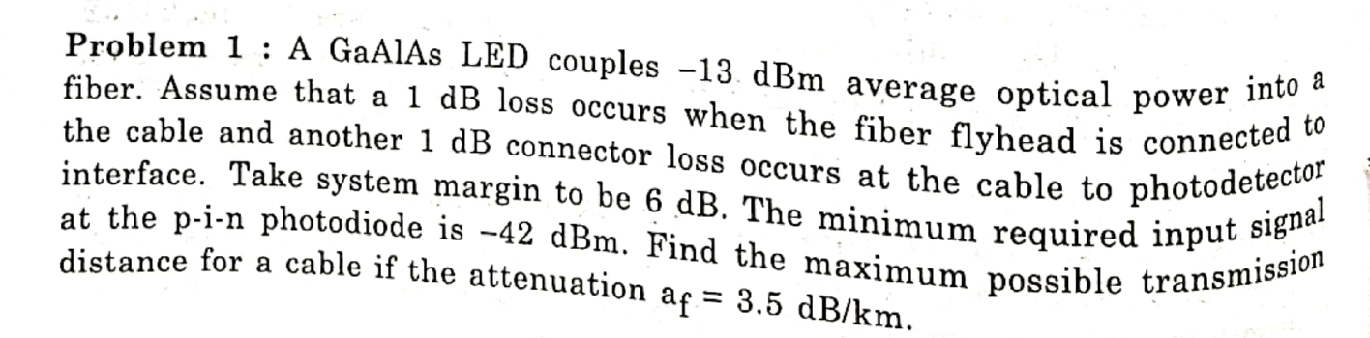

Slide 15
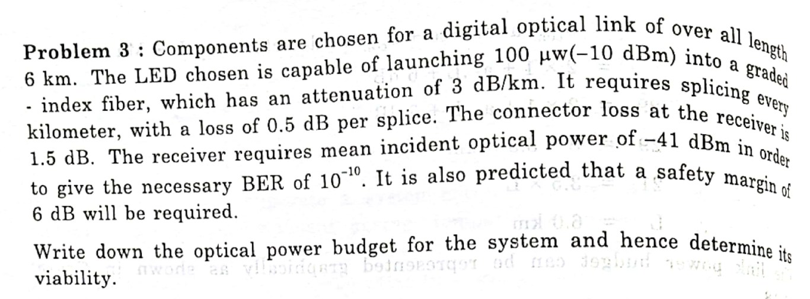

Slide 18
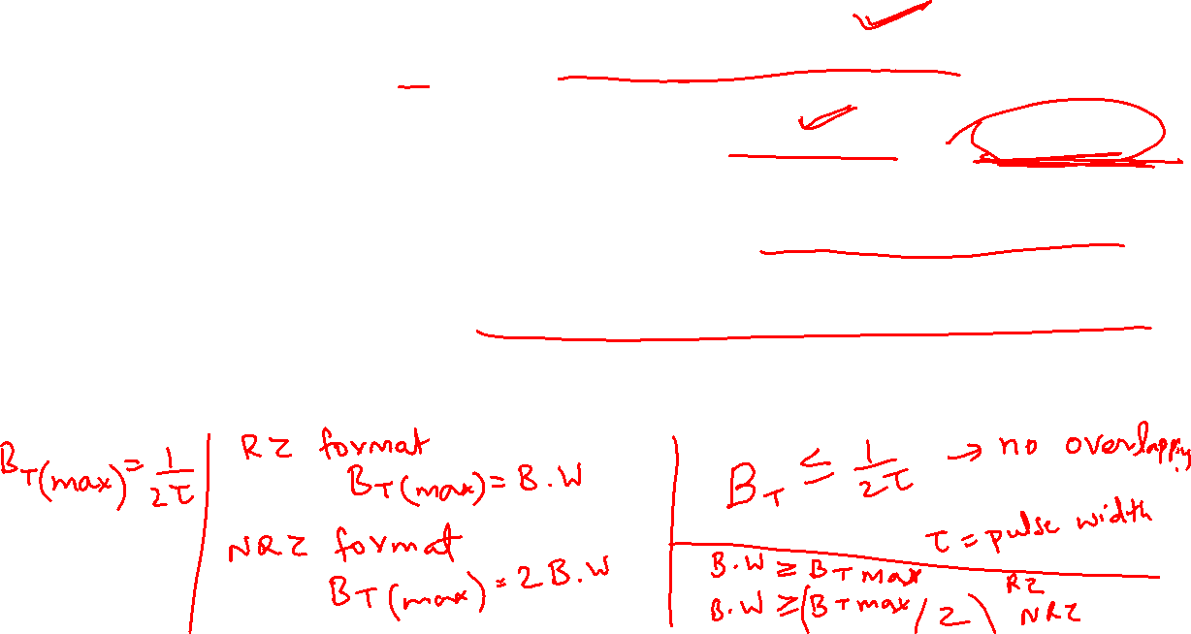
A Rise Time Budget Analysis is a convenient method for determining the dispersion limitation of an Optical Fiber Link.
2.
3.
4.
5.

Slide 19
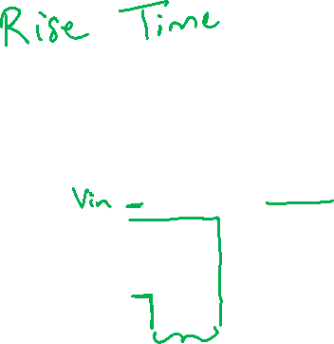

Slide 20
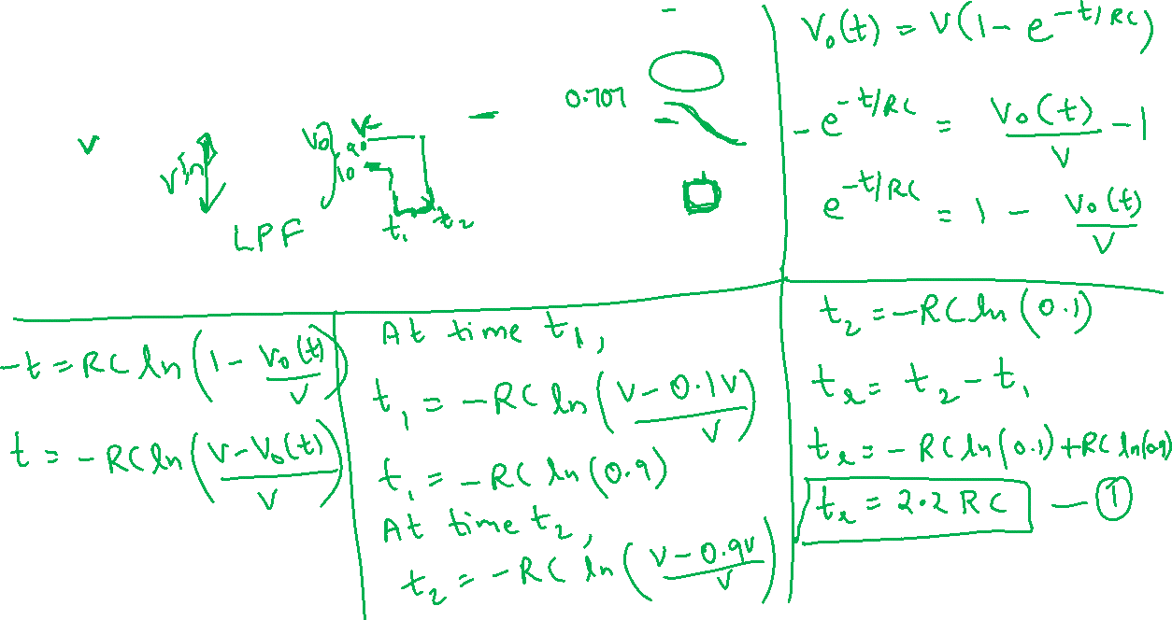
The bandwidth and rise time of a linear system is inversely proportional. In order to understand the concept, let us consider simple RC circuit

Slide 21
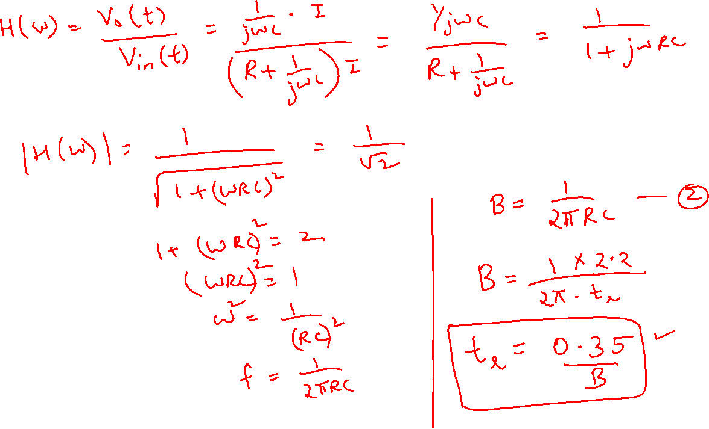

Slide 22
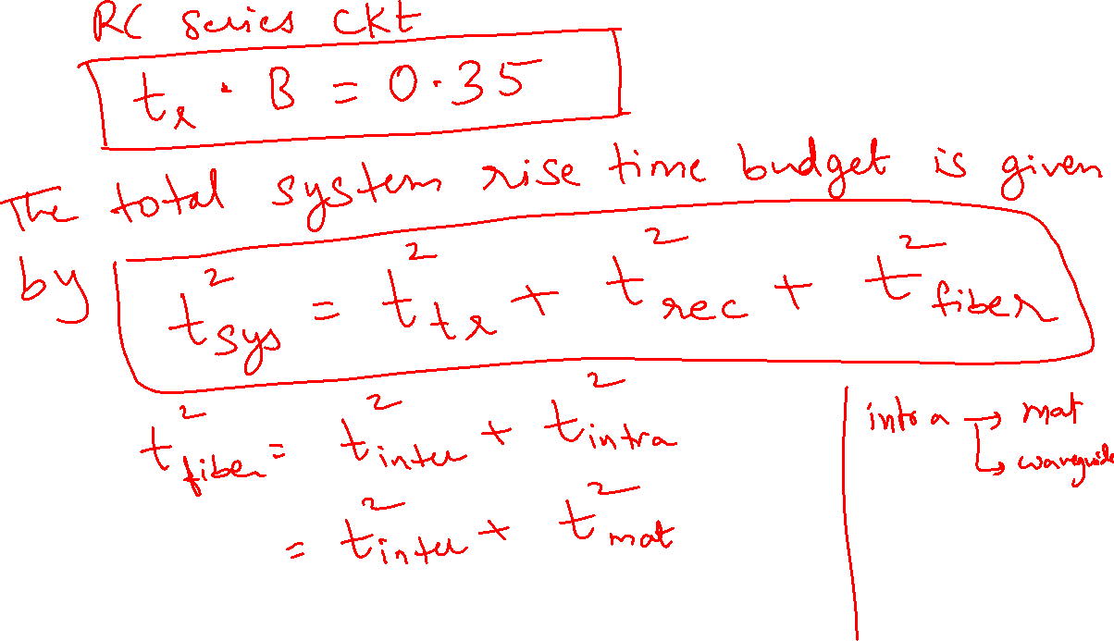

Slide 23
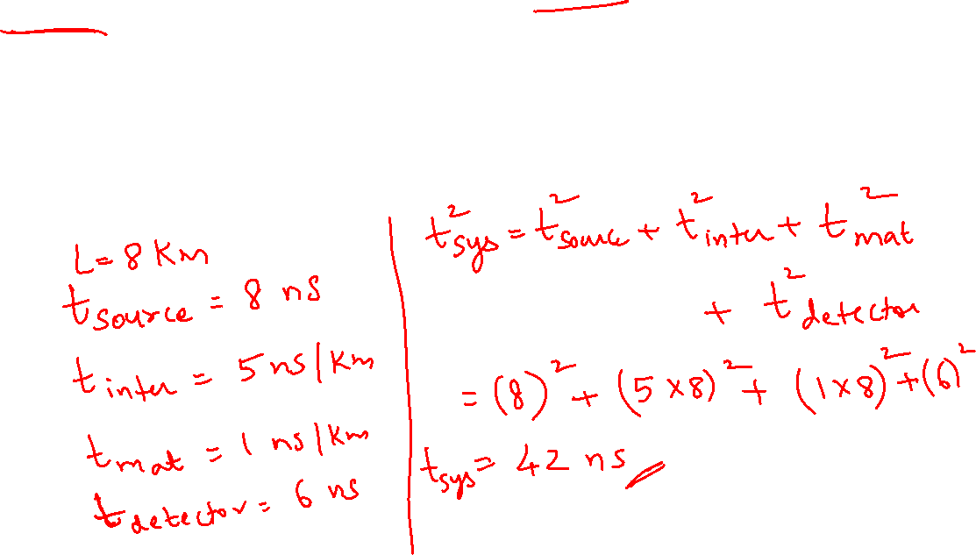

Slide 24
Thank You!
(shyamalae@sies.edu.in)

